Slide 1


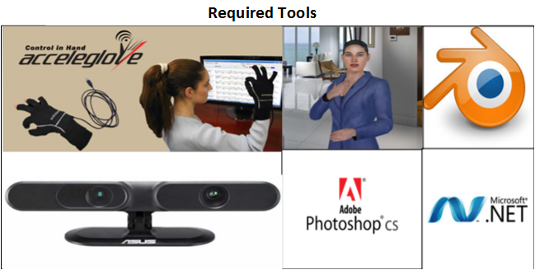
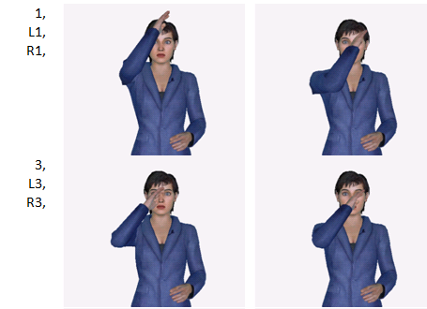
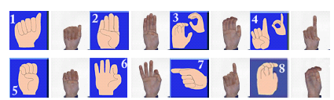
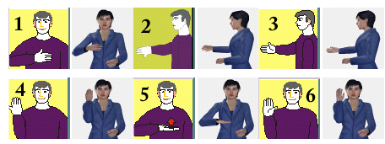
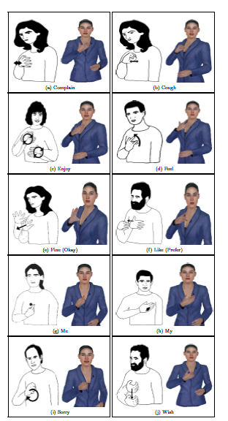

Speech to American Sign Language (ASL)
Animation Engine using 3D Avatar
MdShakil Ahamed
School of Computing and Info. Sciences
Florida International University
11200 SW 8th St, Miami, FL 33199
maham001@cis.fiu.edu
Reza Amini
School of Computing and Info. Sciences
Florida International University
11200 SW 8th St, Miami, FL 33199
ramin001@cis.fiu.edu
Christine Lisetti
School of Computing and Info. Sciences
Florida International University
11200 SW 8th St, Miami, FL 33199
lisetti@cis.fiu.edu
Motivation
Related Work
ASL translation Engine (ATE)
Avatar based sign translation from English to ASL
Real-time interaction between human speech to signing avatar
Capable of converting real-time gesture behavior in avatar.
Capable of generating robust ASL sign words
Parameter sign component based engine which is more
efficient than probability based approach in terms of accuracy
ATE Applications
Facial modality based research for the ASL signers
Sign Language teacher , Signer Health Coach, Signer Virtual patient
Entertainment, web page translator
Challenges:
Creating ASL signs with changing meaning on the fly depends on proper control of face, eye, hand and body movement
Developing broad range of gesture with proper orientation
Controling the gesture speed with proper synchronization
Vcom3D ASL avatar: [H’nerfauth, 2007] , [Andrei ,etal, 2013]
Widely used in ASL gesture
Limitations: not realistic character, less natural motion
DePaul ASL avatar: [Wolfe,1999] , [Kelley, 2011]
ASL applications research
Limitations: Issue with avatar texture quality
Tessa SL avatar: [Hanke, 2014], [Hursley, 2007]
British Sign Language appl.
Limitations: follow word-by-word’ english ordering not ASL
Smartbody SL avatar: [M. Kipp et al. 2011]
Some ASL improving research
Limitations: not user friendly for the novice user
System Architecture, Tools and Snapshot
Evaluation and Results
Future Research & Directions
Current Accomplishment:
48 shapes and 26 right hand orientation codes
72 locations and 41 right hand direction codes
Resolved parameter integration conflicts
Integrated 4 parameters with evaluation
Steps remaining:
Generate left hand shape,
orientation and direction codes
Integrate Speech using SAPI API
Implement words that start
and end with dierent shapes,
orientations, and locations
System subjective and objective
performance evaluation
Current System Limitation
Limited but goal oriented direction of movement code developed which are not enough for very natural movement
Need very precise controlling of the shape and orientation change on the fly of body and hand movement
Only consider hands for sign
Conclusion and future goals
Integrate eye, face, body and hands coordination for sign generation.
Improve degree of naturalness of direction of movement codes using computer vision based gesture recording using Kinect.
Comparative study of sign generation and how accurately avatar can represent signs.
How sign avatar can address health, psychology and pedagogical improvement.
Contact: Affective Social Computing Lab (http://ascl.cis.fiu.edu/)
FIU College of Engineering & Computing 30th Anniversary Celebration
Notes:
Architecture-> right loc[ascl,idrt],
3 rows , quality pictures, same border, width, height

